Slide 1
STEAM DATA Analysis And Prediction
Team members
Yasmeen Kowsar Shaik
Mounica Poreddy
SiriChandhana Banala
Mohammed Shakeer Bandrevu
Javeed Shaik

Slide 2
INTRODUCTION
Steam an internet based digital distribution platform developed by Valve Corporation . It offers DRM, Multiplayer Gaming and Social Networking.
According to the recent statistics, there are over 125 million active steam accounts.
Along with that, it has 781 million registered Video Games, out of which 37% have never even been played, and nearly 2/3rd’s of them haven’t even been launched.

Slide 3
So, currently steam only has around 4,500 games available for Windows, iOS and Linux. Along with 400 million pieces of user generated data.
Surveys from 2013 suggests that 75% of the video games bought online are bought through Steam alone.

Slide 4
Goal Of the Research
The sole purpose of the research is to analyse the steam data (location, Player’s steam level, badges, number of games owned, groups, friends, and most played video game) of several steam accounts, and predict a Video Game for the user based on his/her data.
This research can also be deployed in a far greater scope, and can be used to suggest friends to a user based on the games played.

Slide 5
Steps Taken
Collect data, which is as random as possible.
Train Weka using a good algorithm. (Game based on age and location)
Predict the Output using the algorithm. (i.e; the Game).

Slide 6
Step 1 : Collecting the Data
Data Collection had to be done manually as Valve has denied Steam API key, which is required to access their data.(We needed a premium account to receive API key.)
We have still managed to collect data from over 3200 public steam accounts (out of 75 million).
We considered only a limited number of games to save time.

Slide 7
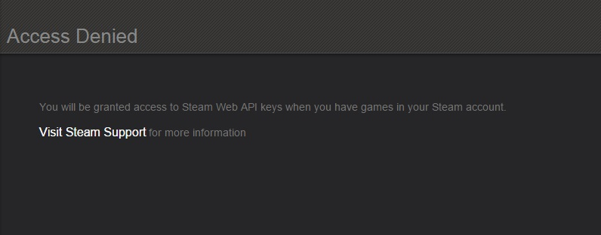
Why Not API?

Slide 8
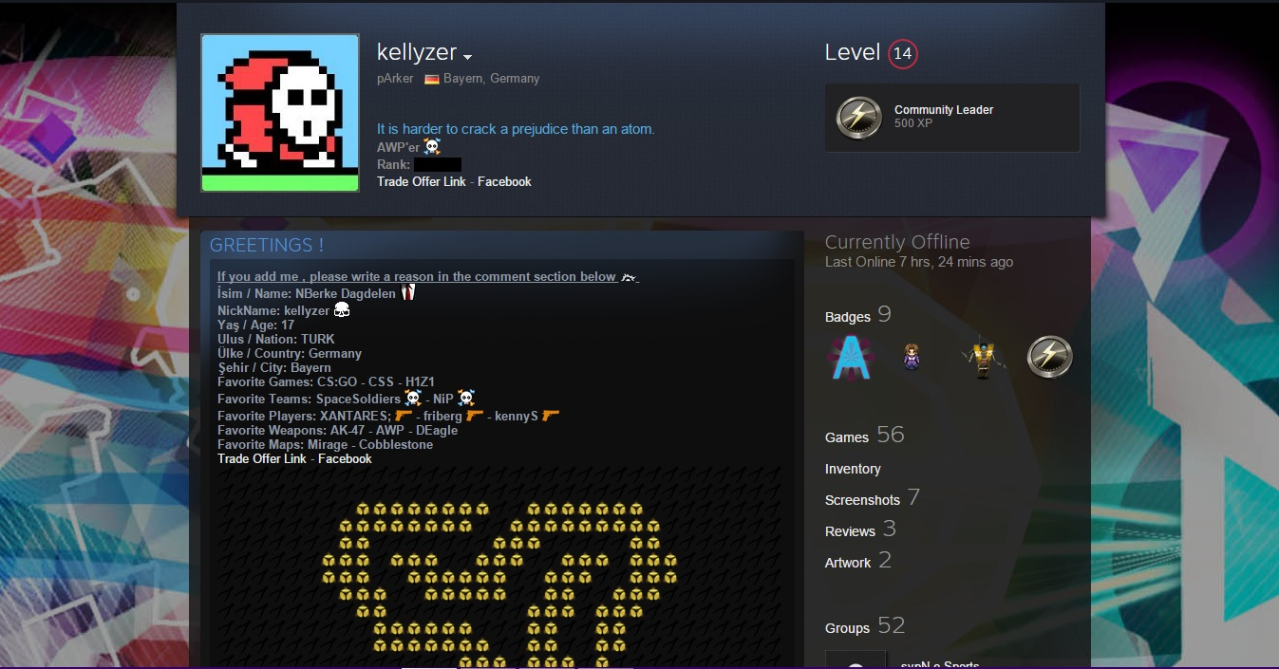
Random Steam Profile

Slide 9
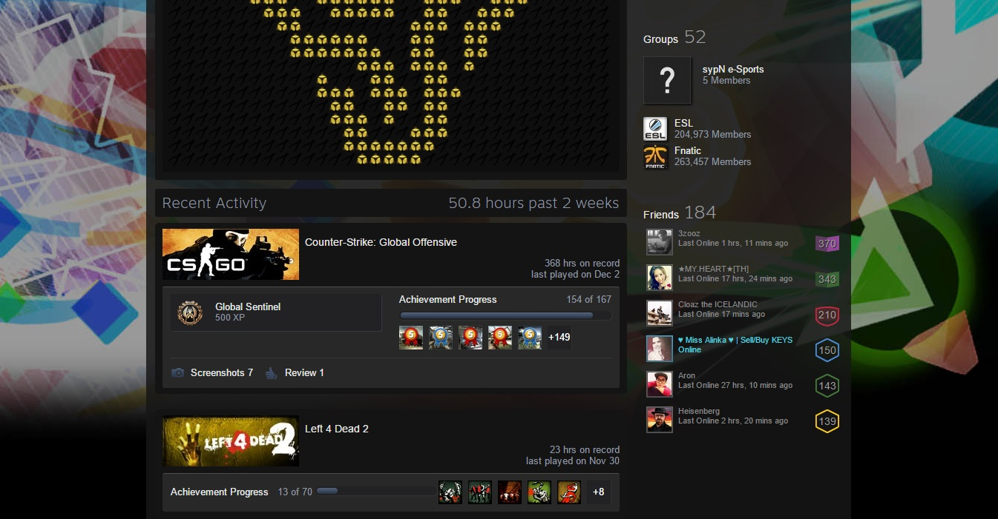
Random Steam Profile

Slide 10
Data Collection (Challenges Faced)
While collecting data, we noticed that a few of the steam profiles had at least one of the required attributes hidden, which left us with 2 choices: We either had to set it as a missing value, or move on to the next steam profile.
Not many had their Location hidden, which easily made us set it missing value, rather than skipping the account.
Given our limited time, it was highly unlikely for us to collect a lot of data, which might’ve actually greatly improved the accuracy.

Slide 11
Data Collection (Challenges Faced)
We planned on grabbing data from at least 20,000 steam accounts(out of 75 million), if we had the API key. Anything more than that much of data wouldn’t have been practical, given our limited processing speed. (Researchers from a website named Arstechnica had to scrape Steam for 80,000-90,000 steam accounts everyday, for about 2 months just to find out the least played games on steam). Now, working on such a huge database, with out limited resources, can prove to be really hard, at the moment.

Slide 12
Step 1 : Data Collection (Continued)
We finally were able to gather data from over 3200 steam accounts.
Tried to be as diverse as possible, but we knew that, not all countries have equal number of players.
Limited the number of games, as we could not have considered all the 6500 games, by entering instances manually.

Slide 13
Attributes
We now have Seven Attributes :
Game (One out of the six, which we considered)
Location (Country)
Steam Level (Numeric)
Number Of Badges (Numeric)
Number of Games/ Products owned (Numeric)
Number of Groups the user is in (Numeric)
Friends of the User (Numeric)

Slide 14
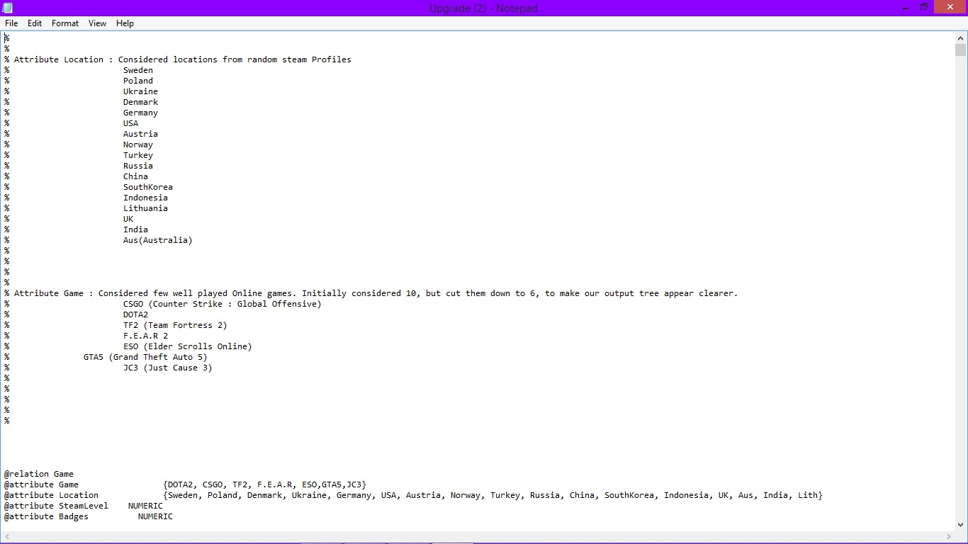
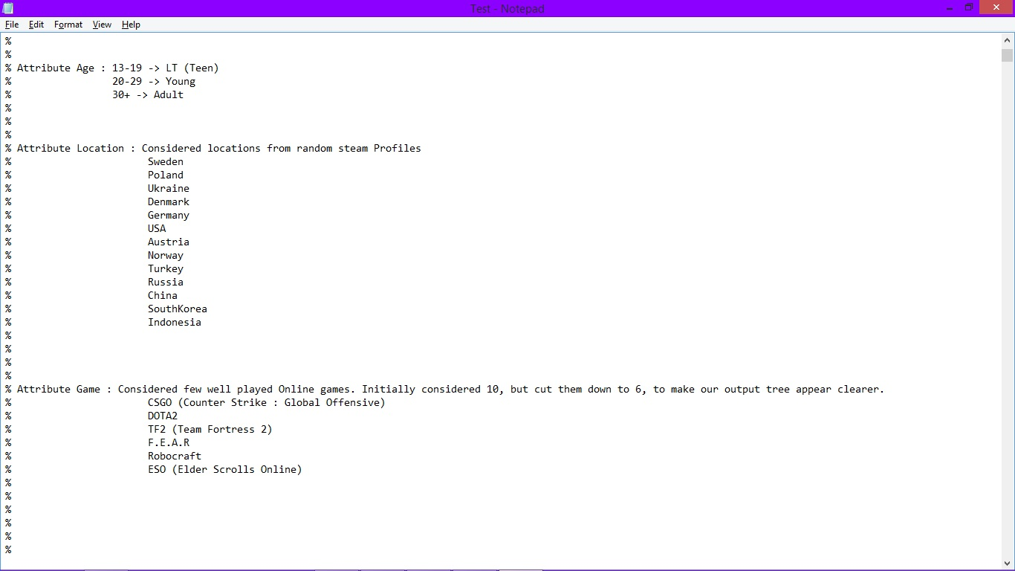

Slide 15
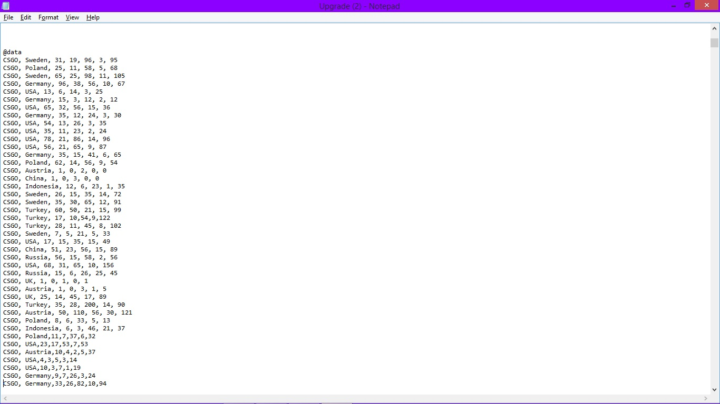
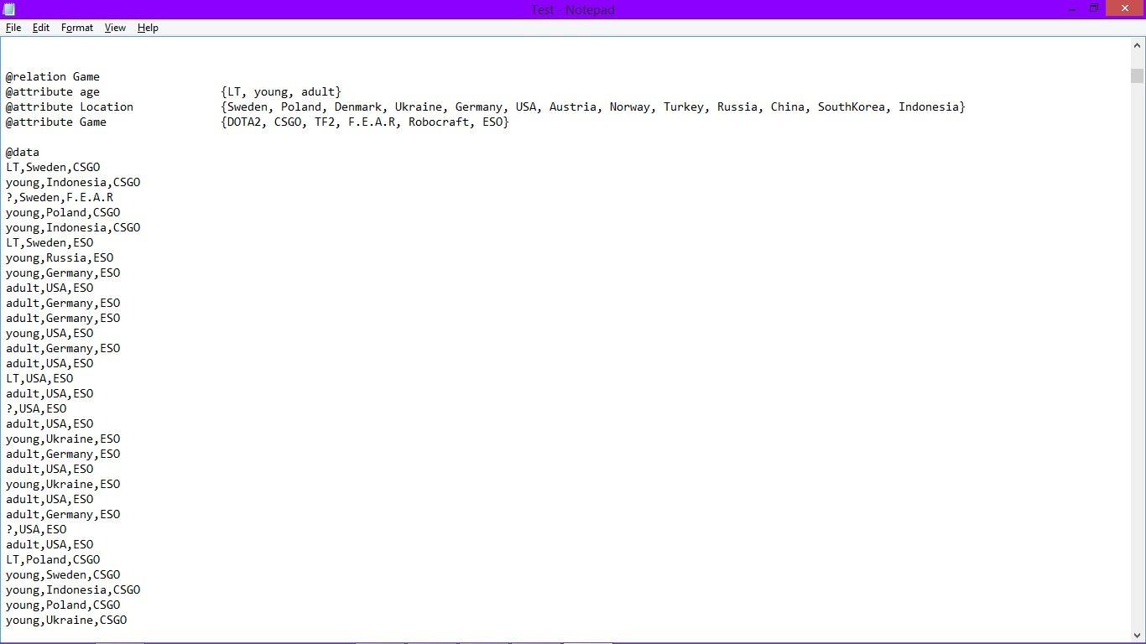

Slide 16
Pre-Processing
This stage has given us broad view upon our survey, which is quite interesting.

Slide 17
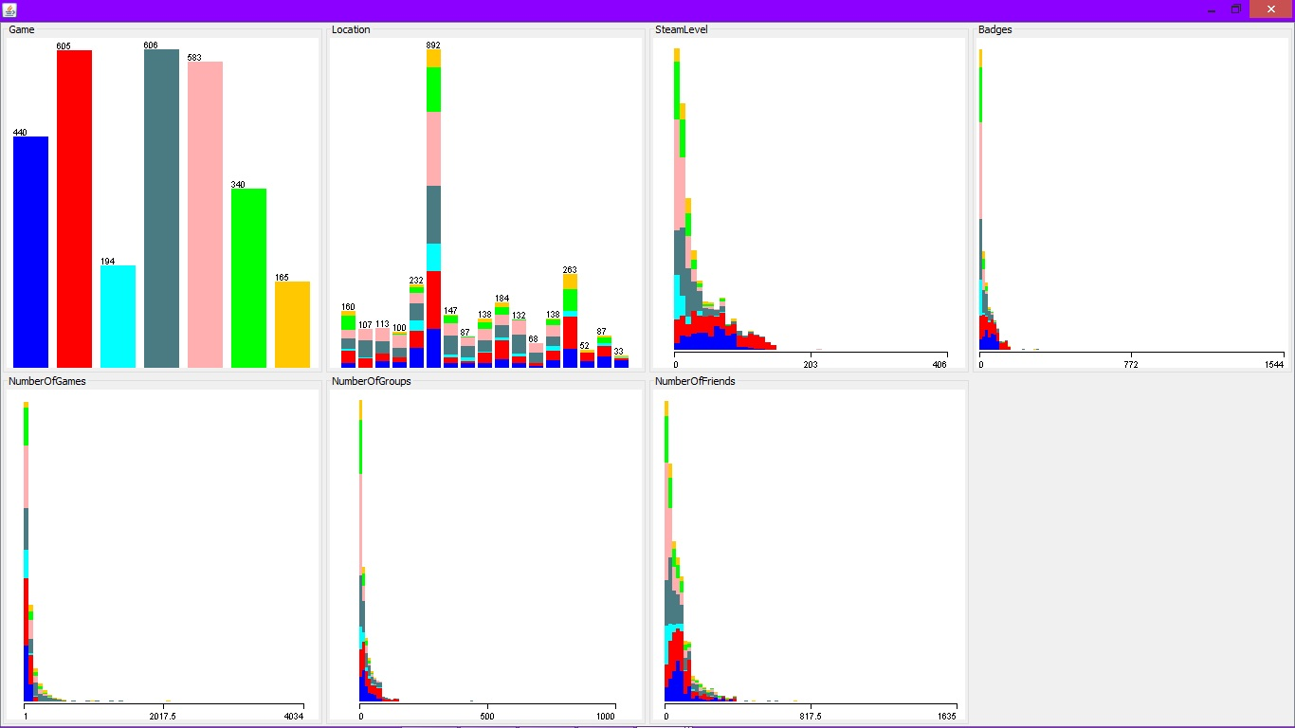

Slide 18
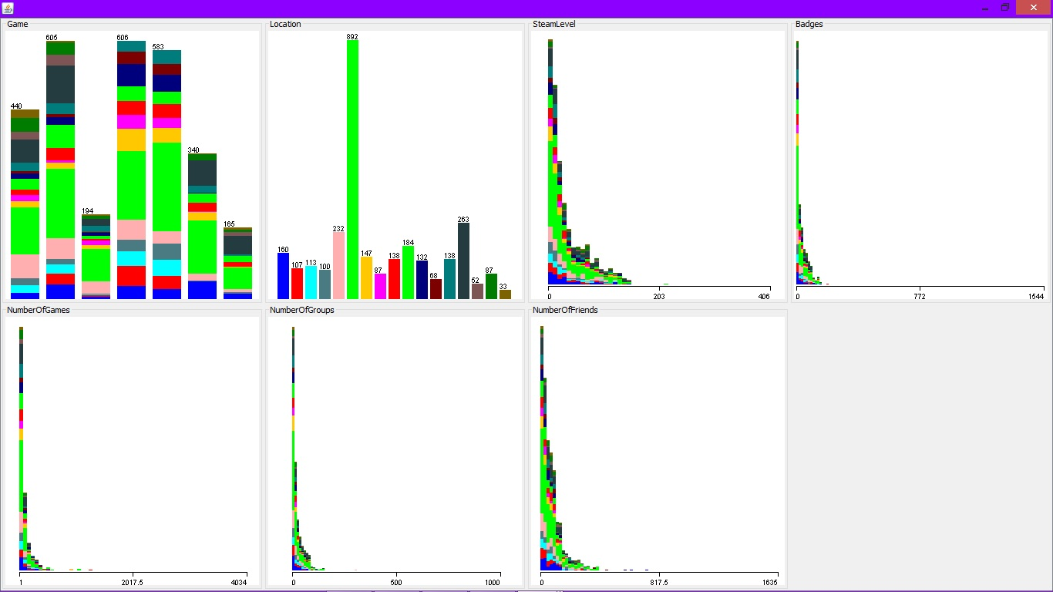

Slide 19
Step 2: Training the Machine
Once we had the data, all that remained was to train and test the data using weka.
We have used several algorithms to pick the best one to train the machine with.
Random Forest Algorithm left us with an whooping 98.54% accuracy, while J48 tree algorithm gave us 87.7%.

Slide 20
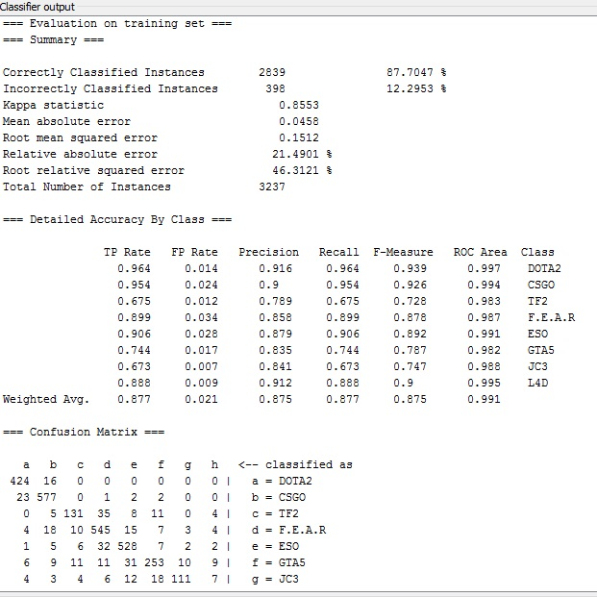
J48 (‘Game’ as label)

Slide 21
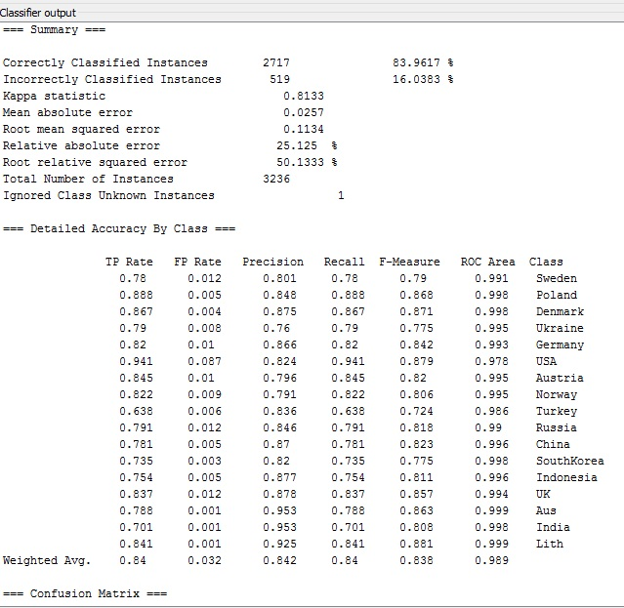
J48 (‘Location’ as Label)

Slide 22
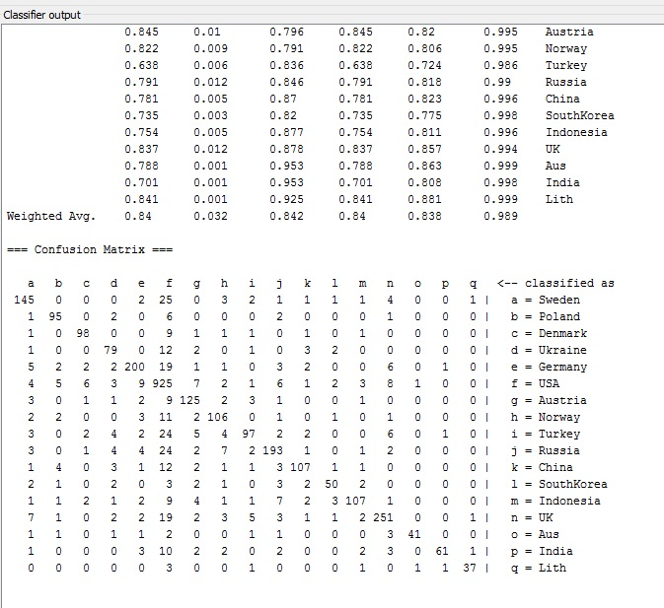
J48(‘Location’ as label continued)

Slide 23
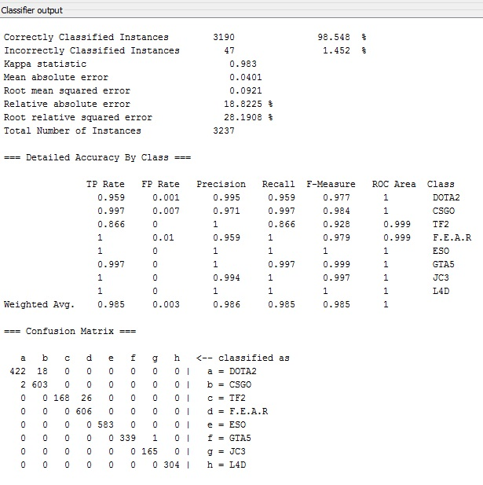
Random Forest (‘Game’ as Label)

Slide 24
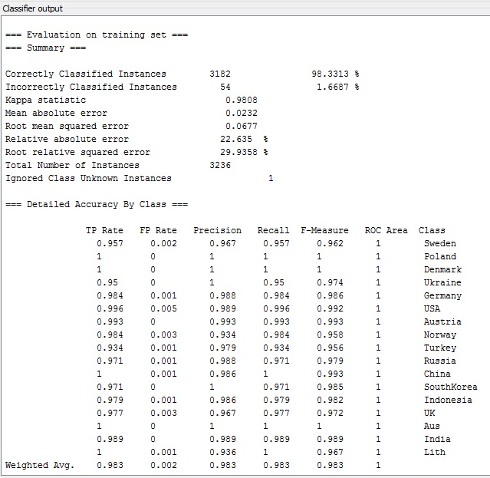
Random Forest (‘Location’ as Label)

Slide 25
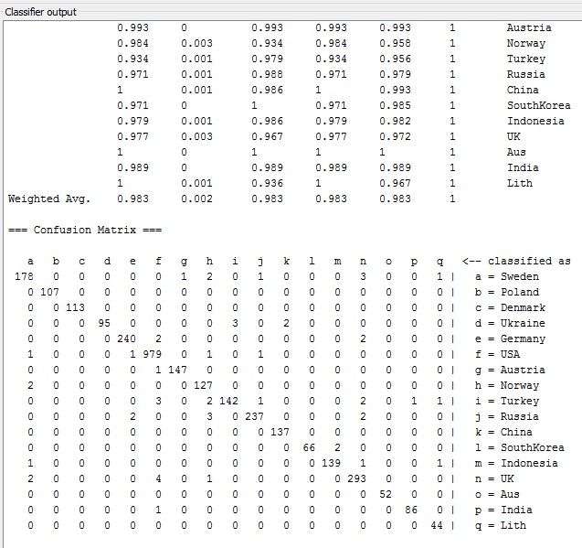
Random Forest (‘Location’ as Label Continued)

Slide 26
Visualizing the Tree
We tried to visualize how the trained machine is thinking, by looking at it’s tree.
And, we got a really complicated response from the machine.
Just to show everyone how complicated the tree is, I have scaled the tree to fit to the screen and selected the least possible font.
Can be demonstrated for a clearer view.

Slide 27
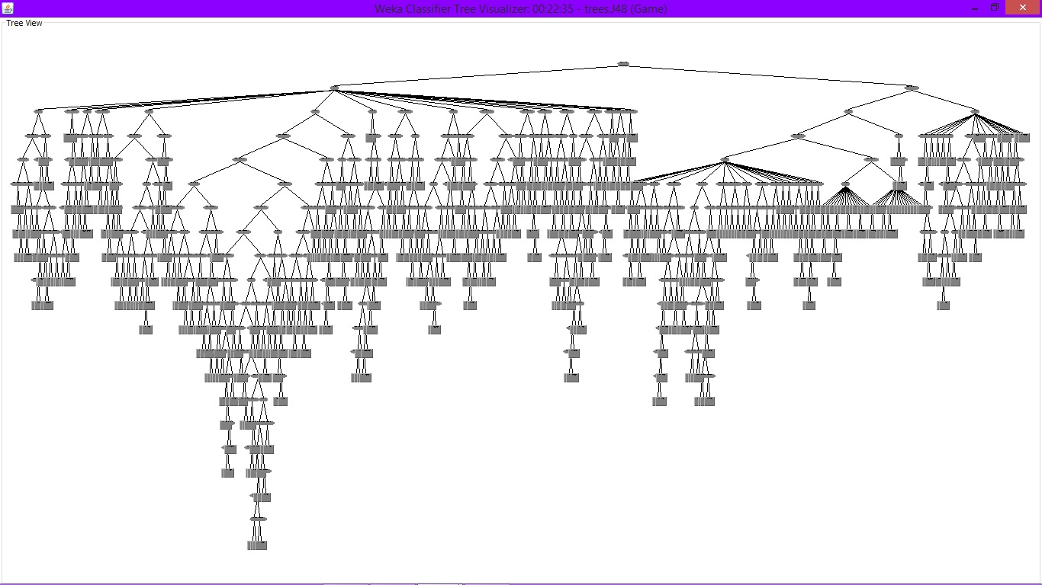
J48 tree for label ‘Game’

Slide 28
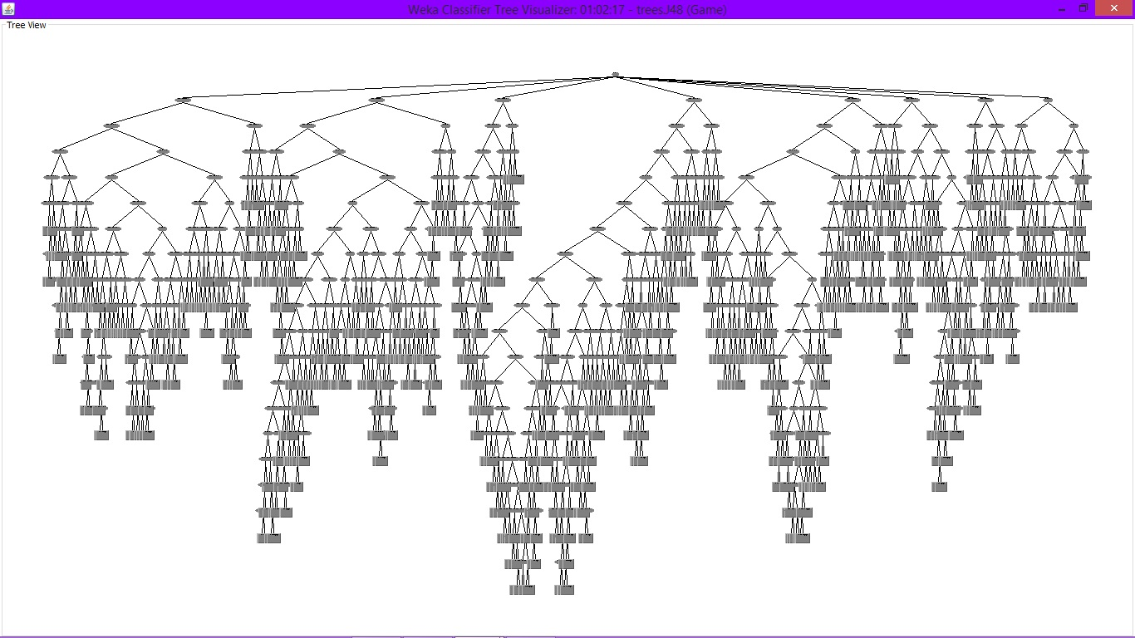
J48 tree for label ‘Location’

Slide 29
Step 3: Prediction
So, we now have a trained machine.
We must now predict a Game for a user, based on the attributes which we have considered.
For this to happen, we must enter a new instance in the arff file, which contains the user’s data, but the ‘Game’ attribute of that instance must be left as a missing value (?)

Slide 30
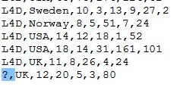
For, example we want to predict a Game for a user from UK, whose, Steam Lvl=12,Badges=20,games=5,groups=3,and number of friends = 80.

Slide 31
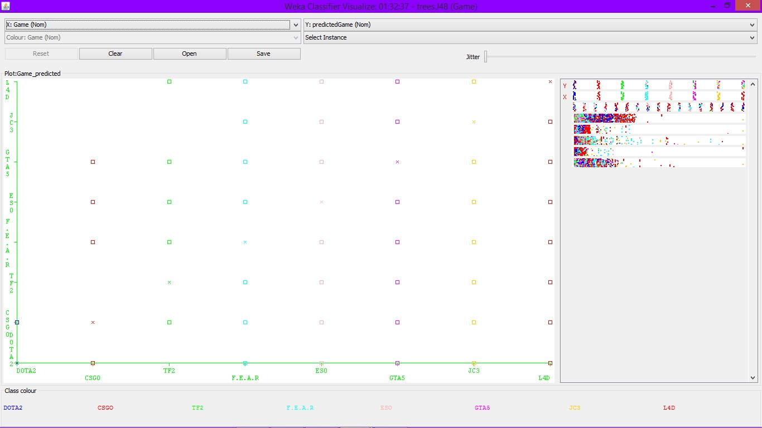
After Running a suitable Algorithm, right click on the result list and click on ‘View Classifier Errors’

Slide 32
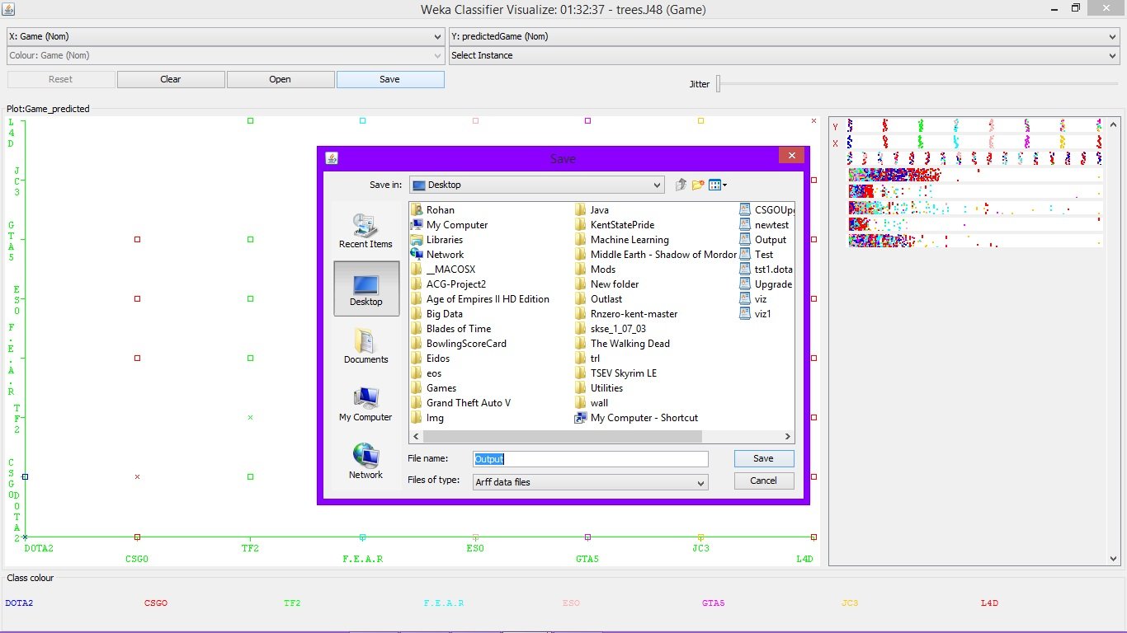
Save the Output file to a location (The output will be saved in the form of an ARFF file).

Slide 33
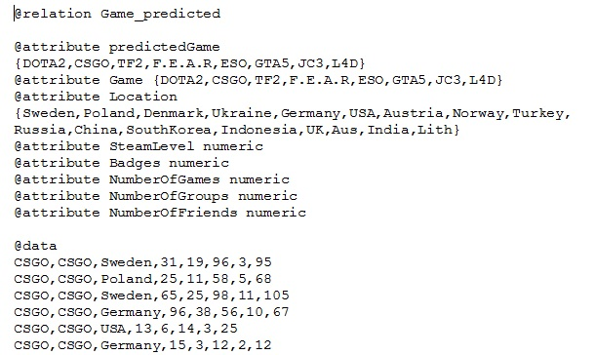
Open the output file using Word.(Notepad will not be clear). We notice that we have a new attribute called ‘predicted Game’ now, which is generated by weka.

Slide 34
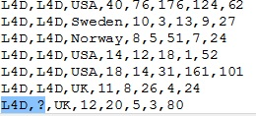
Prediction : Scroll down to the place where we left the missing value to view the prediction.

Slide 35
Result
As we can see from the above slide, weka has predicted that, a user from UK, with a steam level of 12, possessing 20 badges, owns 5 games, is a part of 3 groups, and has 80 people as friends, will most probably play Left for Dead 2(L4D).
Similarly, we can use the same method to predict the location of a user, in case he/she decides to hide it from us.

Slide 36
Further Data Analysis with Label ‘Game’
On further analysis, we noticed that ‘Number of Badges’ is the attribute which had the least correlation with the label ‘Game’.
Removing both ‘Badges’ and ‘Location’ did not affect the accuracy much. The loss in accuracy wasn’t more than 0.3%, even when both of these attributes were removed.

Slide 37
Further Data Analysis with Label ‘Location’
The Attribute ‘Steam Level’ and ‘ had negligible influence on the accuracy when we consider the label ‘Location’.(accuracy drop < 1%)
Attribute ‘Badges’ had low relation with ‘Location’ too (accuracy drop < 1%). There was no significant drop in accuracy when both ‘Badges’ and ‘Steam Level’ were removed.
‘Number of Games’ attribute alone, had a huge impact on the prediction, because removing this attribute, reduced the accuracy but almost 4%.

Slide 38
What can be done to refine the data?
We can clearly eliminate, the attribute ‘Badges’ as it did not have much correlation with both the labels (Game & Location).
The attribute ‘Steam Level’ can be removed too.
Removing attributes might make the data lighter, but it also makes it less accurate at the same time.

Slide 39
Possibilities
This research is basically, just an idea how a game can be predicted and sent as a suggestion to the user, by the steam application, by just taking into the account, the user’s steam data.
(This is subjected to perspective) -> If a user decides to hide his/her location for some reason, but yet, we use this trained machine to predict the user’s location(since, we will be correct 98% of the time), can be considered as violation of privacy.

Slide 40
Conclusion (More Possibilities)
To improve the accuracy, more attributes(‘Last time online’, ‘Recently Played games’, ‘Wish list’, ‘Time spent online’, ‘Time of Login’) and data(more number of steam profile data) can be added. However, a few of these attributes can be viewed by the server managers themselves, but not to other users, hence making it a very powerful tool in hands of the steam developers.

Slide 41
References for fact checking
http://www.forbes.com/sites/erikkain/2014/04/17/nearly-37-of-all-registered-steam-games-have-never-been-played/
http://arstechnica.com/gaming/2014/04/introducing-steam-gauge-ars-reveals-steams-most-popular-games/
https://steamcommunity.com/
http://www.ongamers.com/articles/top-100-counter-strike-players-of-all-time-by-prize-money-won/1100-508/
http://store.steampowered.com/app/730/
http://store.steampowered.com/app/440/

Slide 42
References
http://store.steampowered.com/app/730/
http://store.steampowered.com/app/440/

